Slide 1
Graphs

Slide 2
This Lecture
Aims
General Terminology
Vertices, Edges, Connectedness, Path, Cycle etc.
SubTypes
DiGraphs, Trees
Representation techniques
Adjacency List, Adjacency Matrix

Slide 3
Graphs
A
C
B
D
Idea: A Graph is a set of nodes connected by edges

Slide 4
Graphs
A
C
B
D
very helpful to store and analyse relationships between objects

Slide 5
Graphs
A
C
B
D
very helpful to store and analyse relationships between objects
many real life applications

Slide 6
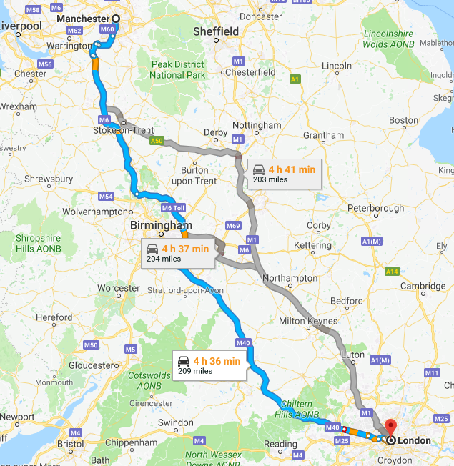
Fastest Route
google map

Slide 7
Fastest Route
google map
nodes = cities, edges = roads

Slide 8
Fastest Route
google map
nodes = cities, edges = roads

Slide 9
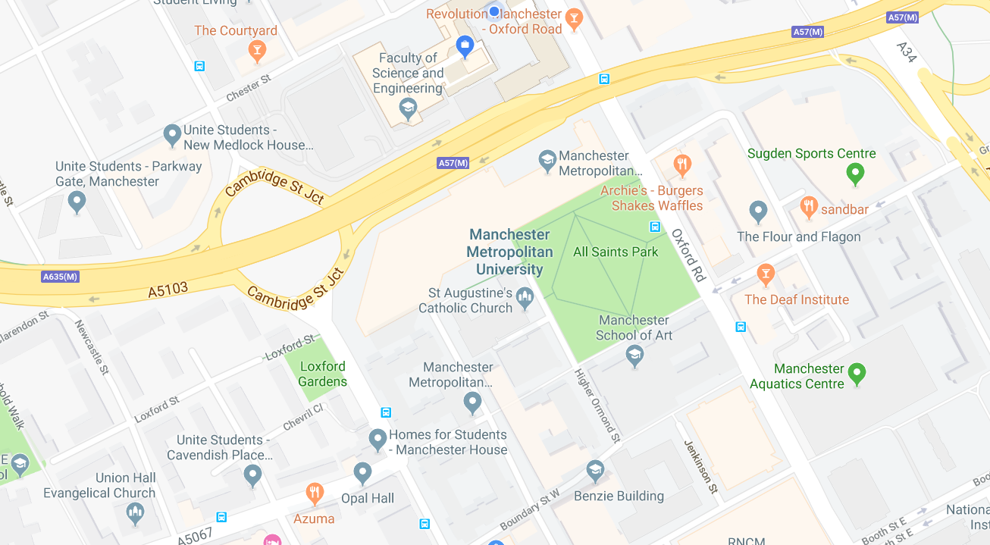
Shortest Path

Slide 10
Shortest Path
nodes = intersections, edges = roads

Slide 11
Shortest Path
nodes = intersections, edges = roads

Slide 12

Computer Networks
nodes = computers, edges = communication channels

Slide 13
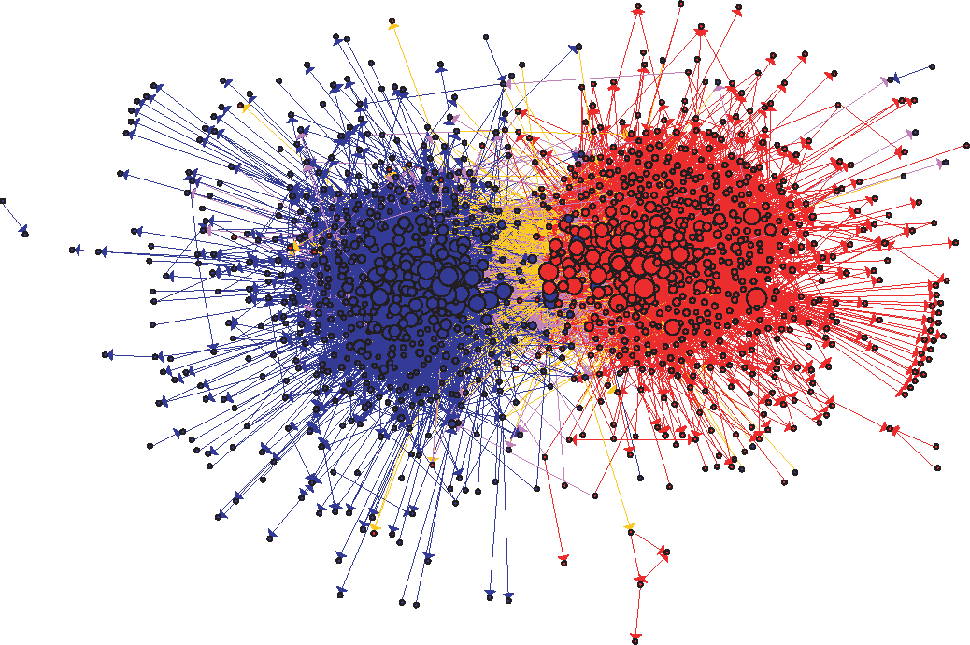
Social Networks
nodes = political blogs, edges = cross-references
The political blogosphere and the 2004 U.S. election: divided they blog

Slide 14
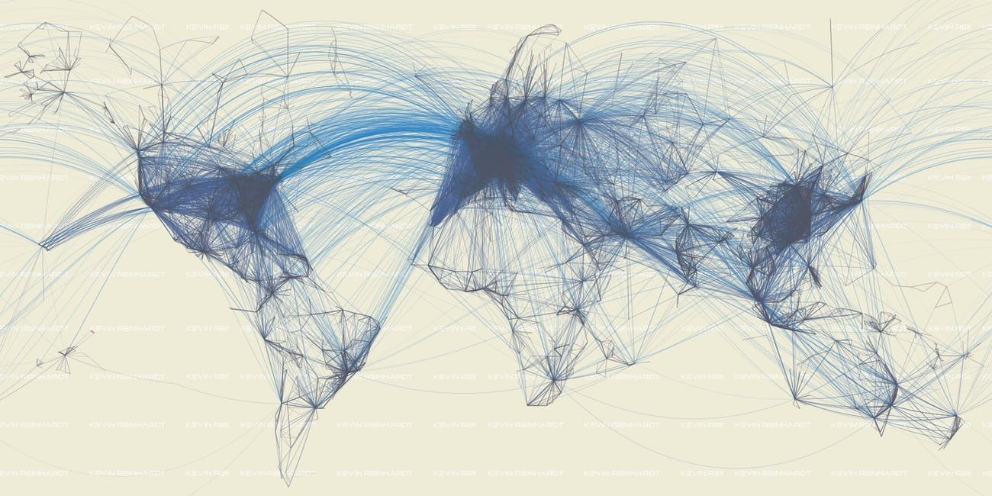
Flight Map
edges = direct flights

Slide 15
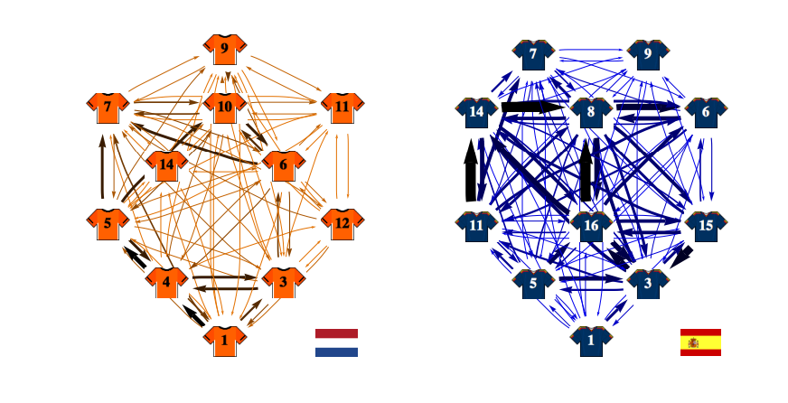
Passing Network
arXiv:1206.6904
FIFA 2010 World Cup

Slide 16
Graphs and Terminology
Graph G is the data structure specified by the pair G = < V, E >
V set of vertices (or nodes)
E set of (unordered) pairs on V called edges (or arcs) :
(E ⊂ V x V)
e.g.
G₁ = < a, b, c, d, e, (a,b), (b,e), (e,c), (c,d), (b,d)>
Connectedness
If (a,b) ∈ E then there is an edge between a and b;
a and b are adjacent;
a and b are connected;
there is a path between a and b.
a
b
e
c
d

Slide 17
Graphs and Terminology
Graph G is the data structure specified by the pair G = < V, E >
V set of vertices (or nodes)
E set of (unordered) pairs on V called edges (or arcs) :
(E ⊂ V x V)
e.g.
G₁ = < a, b, c, d, e, (a,b), (b,e), (e,c), (c,d), (b,d)>
Connectedness
If (a,b) ∈ E then there is an edge between a and b;
a and b are adjacent;
a and b are connected;
there is a path between a and b.
a
b
e
c
d

Slide 18
Graphs and Terminology
If there's a path from a to b, and a path from b to e, then there is a path from a to e.
vertices on path must be distinct (unless first = last)
A graph G is connected if there is a path between any given pair of vertices.
Otherwise its an unconnected graph
A path from a vertex to at least one other node and back to itself is a closed path or cycle.
A graph G with at least one cycle is a cyclic graph.
Otherwise acyclic
b
a
e
c
d
connected, cyclic
b
a
e
c
d
unconnected

Slide 19
Graphs and Terminology
If there's a path from a to b, and a path from b to e, then there is a path from a to e.
vertices on path must be distinct (unless first = last)
A graph G is connected if there is a path between any given pair of vertices.
Otherwise it is an unconnected graph
A path from a vertex to at least one other node and back to itself is a closed path or cycle.
A graph G with at least one cycle is a cyclic graph.
Otherwise acyclic
b
a
e
c
d
connected, cyclic
b
a
e
c
d
unconnected

Slide 20
Graphs and Terminology
If there's a path from a to b, and a path from b to e, then there is a path from a to e.
vertices on path must be distinct (unless first = last)
A graph G is connected if there is a path between any given pair of vertices.
Otherwise it is an unconnected graph
A path from a vertex to at least one other node and back to itself is a closed path or cycle.
A graph G with at least one cycle is a cyclic graph.
Otherwise acyclic
b
a
e
c
d
connected, cyclic
b
a
e
c
d
unconnected

Slide 21
Trees are Special Graphs
G
B
H
L
A
C
acyclic graph

Slide 22
Directed graph (digraph)
A Directed graph G is the data structure specified by the pair G = < V, E >
V is the set of vertices (or nodes)
E is the set of ordered pairs on V
(E ⊂ V x V is a binary relation on V)
If (a,b) ∈ E then there is an edge from a to b
but not necessarily an edge from b to a.
On a diagram (digraph) an edge is represented by an arrow.
a
b
e
c
d

Slide 23
Directed graph (digraph)
A Directed graph G is the data structure specified by the pair G = < V, E >
V is the set of vertices (or nodes)
E is the set of ordered pairs on V
(E ⊂ V x V is a binary relation on V)
If (a,b) ∈ E then there is an edge from a to b
but not necessarily an edge from b to a.
On a diagram (digraph) an edge is represented by an arrow.
a
b
e
c
d

Slide 24
Directed graph (digraph)
Draw digraphs
G1=<a,b,c,d,e, (a,b),(a,c),(c,d),(c,e)>
G2=<a,b,c,d, (a,a),(a,b),(b,c),(c,a),(c,d)>
a
b
e
a
b
c
d
d
c
Unconnected - no directed path
between e,d
Weakly connected – undirected paths
for all pairs of nodes
Acyclic
Binary Tree
Longest path = 3 nodes
Cyclic
No longest path - cyclic

Slide 25
Mother Vertex of a Digraph
A mother vertex in a graph G = <V,E> is a vertex v such that
all other vertices in G can be reached by a path from v.
0
2
1
5
3
4
6

Slide 26
Mother Vertex of a Digraph
A mother vertex in a graph G = <V,E> is a vertex v such that
all other vertices in G can be reached by a path from v.
0
2
1
5
3
4
6
From node 0 can reach : 1, 2, 3

Slide 27
Mother Vertex of a Digraph
A mother vertex in a graph G = <V,E> is a vertex v such that
all other vertices in G can be reached by a path from v.
0
2
1
5
3
4
6
From node 1 can reach : 3

Slide 28
Mother Vertex of a Digraph
A mother vertex in a graph G = <V,E> is a vertex v such that
all other vertices in G can be reached by a path from v.
0
2
1
5
3
4
6
From node 2 can reach : nothing

Slide 29
Mother Vertex of a Digraph
A mother vertex in a graph G = <V,E> is a vertex v such that
all other vertices in G can be reached by a path from v.
0
2
1
5
3
4
6
From node 3 can reach : nothing

Slide 30
Mother Vertex of a Digraph
A mother vertex in a graph G = <V,E> is a vertex v such that
all other vertices in G can be reached by a path from v.
0
2
1
5
3
4
6
From node 4 can reach : 1, 3

Slide 31
Mother Vertex of a Digraph
A mother vertex in a graph G = <V,E> is a vertex v such that
all other vertices in G can be reached by a path from v.
0
2
1
5
3
4
6
From node 5 can reach : 2, 6, 0, 1, 3, 4 (all)
node 5 is a mother vertex

Slide 32
Mother Vertex of a Digraph
A mother vertex in a graph G = <V,E> is a vertex v such that
all other vertices in G can be reached by a path from v.
0
2
1
5
3
4
6
From node 6 can reach : 4, 0, 2, 1, 3

Slide 33
Graph Data Structures
2 Common techniques
Adjacency List
Adjacency Matrix
Adjacency List
create a list for each vertex v
insert into list all vertices which are adjacent to vertex v (order not important)
if there are no adjacent vertices {degree v = 0},
the list is empty
a → b → d → null
b → e → null
c → a → d →null
d → e → null
e → null

Slide 34
Graph Data Structures
2 Common techniques
Adjacency List
Adjacency Matrix
Adjacency List
create a list for each vertex v
insert into list all vertices which are adjacent to vertex v (order not important)
if there are no adjacent vertices {degree v = 0},
the list is empty
a
b
a → b → d → null
b → e → null
c → d →a → null
d → e → null
e → null
e
d
c

Slide 35



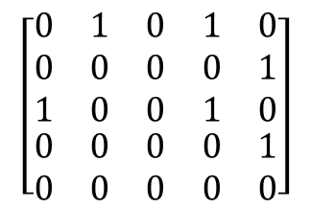

Graph Data Structures
Adjacency Matrix
Create the rows and columns based on the vertices/nodes
if there is an edge from one vertex to another, label it as 1, otherwise 0.
a
b
e
d
c

Slide 36



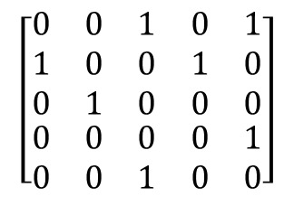

Graph Data Structures
Adjacency list and adjacency matrix
c
a
b
e
d
a → c → e → null
b → a → d → null
c → b →null
d → e → null
e → c → null

Slide 37
List vs Matrix
adjacency list
essentially dynamic
cheaper on memory, requires storage only for existing edges
finding adjacent vertices (neighbours) quicker
more expensive to see if edge from u to v
find list for u, traverse looking for v
adjacency matrix
essentially static
expensive on memory, requires storage for all possible edges (complete graph)
very easy to see if edge from u to v
finding paths may be more expensive

Slide 38
List vs Matrix
adjacency list
essentially dynamic
cheaper on memory, requires storage only for existing edges
finding adjacent vertices (neighbours) quicker
more expensive to see if edge from u to v
find list for u, traverse looking for v
adjacency matrix
essentially static
expensive on memory, requires storage for all possible edges (complete graph)
very easy to see if edge from u to v
finding paths may be more expensive

Slide 39
Implementation: Graph Classes
We'll use the adjacency list
2 classes
GraphNode //it is the single node
Node id (data stored in the node), adjacency list
Graph //it is the entire graph
List of all nodes in graph, methods for add/delete nodes, edges, graph traversal etc.
A
A
B
A
B
A
id
B
adjList
GraphNode
Notes:
Think of Node ID as the label (name) of the node

Slide 40
Implementation: Graph Classes
We'll use the adjacency list
2 classes
GraphNode //it is the single node
Node id (data stored in the node), adjacency list
Graph //it is the entire graph
List of all nodes in graph, methods for add/delete nodes, edges, graph traversal etc.
Graph
A
A
B
A
B
A
id
B
adjList
list of all nodes in the graph
Notes:
GraphNode represents the node of the Graph. Graph represents the entire Graph
Think of Node ID as the label (name) of the node

Slide 41
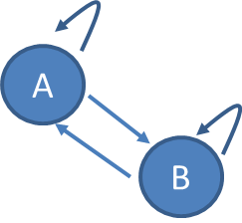
Implementing GraphNode & Graph
GraphNode // the single node (id of node is generic)
Members
T id
LinkedList<T> adjList
Constructor – GraphNode (T id)
Property (set/get) ID
void AddEdge(GraphNode to)
Add to.ID to adjList
LinkedList<T> GetAdjList()
Graph // the entire graph
Members: LinkedList<GraphNode> nodes
Constructor – graph
void AddNode(T id)
void AddEdge(T from, T to)
GraphNode GetNodeByID(T id)
bool IsEmptyGraph()
bool ContainsGraph(graphNode node)
bool IsAdjacent(GraphNode from, GraphNode to)
GraphNode
adjList
id
A
B
A
B
A
B

Slide 42
Implementing GraphNode & Graph
GraphNode // the single node (id of node is generic)
Members
T id
LinkedList<T> adjList
Constructor – GraphNode (T id)
Property (set/get) ID
void AddEdge(GraphNode to)
Add to.ID to adjList
LinkedList<T> GetAdjList()
Graph // the entire graph
Members: LinkedList<GraphNode> nodes
Constructor – graph
void AddNode(T id)
void AddEdge(T from, T to)
GraphNode GetNodeByID(T id)
bool IsEmptyGraph()
bool ContainsGraph(graphNode node)
bool IsAdjacent(GraphNode from, GraphNode to)
Graph
A
B
A
B
A
B
nodes

Slide 43
Graphs and Trees
B
B
D
A
C
A
C
tree
B has only 2 adjacent nodes
graph
B has 3 adjacent nodes
but graphs and trees are similar

Slide 44
namespace Graphs
{
public class GraphNode<T>
{
private T id;
private LinkedList<T> adjList;
public GraphNode(T id)
{
this.id = id;
adjList = new LinkedList<T>();
}
public T ID
{
set { id = value; }
get { return id; }
}
//add (directed) edge from this node
public void AddEdge(GraphNode<T> to)
{
adjList.AddFirst(to.ID);
}
//return the adjacency list of the node
public LinkedList<T> GetAdjList()
{
return adjList;
}
}
}
namespace Tree
{
class Node<T> where T : IComparable
{
public T data;
public Node<T> Left, Right;
public Node(T item)
{
data = item;
Left = null;
Right = null;
}
public T Data
{
set { data = value; }
get { return data; }
}
}
}

Slide 45
namespace Graphs
{
public class Graph<T> where T : IComparable
{ //list of all nodes in the graph
private LinkedList<GraphNode<T>> nodes;
public Graph()
{
nodes = new LinkedList<GraphNode<T>>();
}
public bool IsEmptyGraph()
{
return nodes.Count==0;
}
public bool ContainsGraph(GraphNode<T> node)
{
//search based on ID
foreach (GraphNode<T> n in nodes)
{
if (n.ID.CompareTo(node.ID) == 0)
return true;
}
return false;
}
public void AddNode(T id)
{
GraphNode<T> n = new GraphNode<T>(id);
nodes.AddFirst(n);
}

Slide 46
GetNodeByID
Return the GraphNode with the id
Pseudocode
GraphNode GetNodeByID(T id )
{
foreach(GraphNode n in nodes )
{
if (id same as n.ID)
return n;
}
return null;
}
nodes
A
B
A
B
A
B

Slide 47
AddEdge
public void AddEdge(T from, T to)
{
GraphNode<T> n1 = GetNodeByID(from);
GraphNode<T> n2 = GetNodeByID(to);
n1.AddEdge(n2);
// need to add some validations (eg n1 or/and n2 null)
}

Slide 48
IsAdjacent
Returns true if GraphNode “to” is adjacent to
GraphNode “from”; otherwise returns false
nodes
A
B
A
Pseudocode
bool IsAdjacent(GraphNode from, GraphNode to)
{
foreach(GraphNode n in nodes)
{
if (n.ID same as from.ID)
{ if (from.AdjList contains to.ID)
return true;
}
}
return false;
}
B
A
B
Use:
LinkedList<T> GetAdjList( ) (class GraphNode)
LinkedList<> has built-in Contains method
Notes:
AdjList is a private field of the GraphNode class. Need to ask the node for its adjacent list (use public method GetADjList())
Since the ADjList is a C#LinkedList then we can use the method Contains” to see if the ID is contained in the list

Slide 49
Summary
General Terminology
Vertices, Edges, Connectedness, Path, Cycle etc.
SubTypes
DiGraphs, Trees
Representation techniques
Adjacency List, Adjacency Matrix
Implement Adjacency List
using LinkedList Collection

